Slide 1
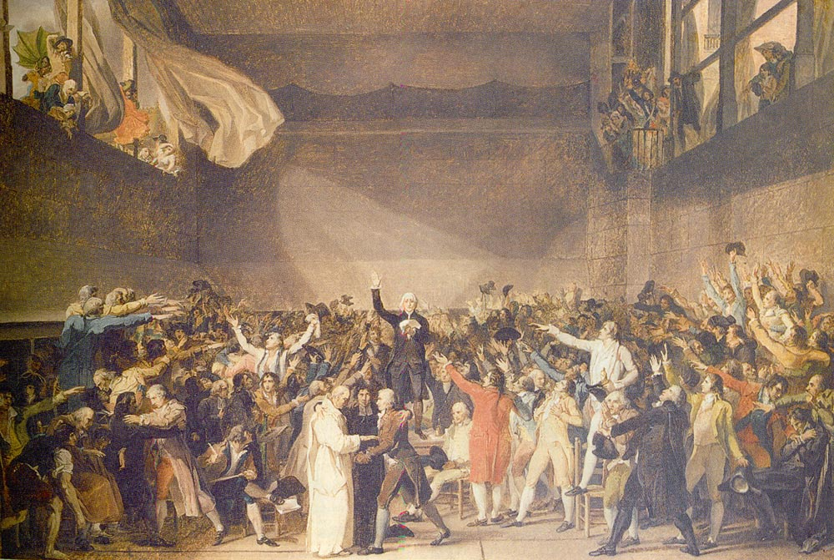
THE FRENCH REVOLUTION
PART ONE: BACKGROUND TO THE REVOLUTION

Slide 2
INTRODUCTION
Which one? That’s the problem with revolutions. There’s just so darn many of them. In France, revolution has happened a number of times. There were two major ones – the Revolution of 1789 and the Revolution of 1848. And those were actually a series of events that lasted years.
However, we’re going to look at the one that is most well-known as the French Revolution – that of 1789-1799 – which forever transformed France, and the rest of Europe, and led it away from control by the monarchy.

Slide 3
ABSOLUTE MONARCHY
There’s an old saying that “absolute power corrupts absolutely,” and that’s the kind of power the kings of some countries in Europe had in the 17th and 18th centuries – notably, France.
An absolute monarchy is one where the king or queen has all the power and there is no constitution to restrict their control. They can essentially do whatever they feel like. Power can only be passed by birth or marriage, and the monarch answers to no one, except in matters of the church.
While there were some limits on the power of the monarchy in France, and it certainly faced challenges, the basic power of the nation was still concentrated in the hands of the king.

Slide 4
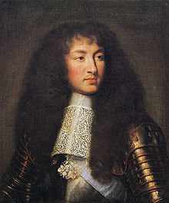
LOUIS XIV, “THE SUN KING”
One of the most well-known examples of an absolute monarch is the French King Louis XIV. He even once proclaimed “L’Etat, c’est moi” (“I am the state”).
Louis XIV believed in the divine right of kings to rule, and he ruled over France for the longest period of any documented monarch in European history – from 1643 to 1715.
In fact, he was king for so long that the next king, Louis XV, was his grandson, since he had outlived all his sons!

Slide 5
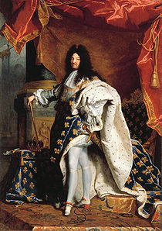
LOUIS XIV’S REIGN
While Louis XIV ruled with absolute power, he was quite a well-liked and successful king. Under his reign, France was the leading European power of its day, and established a naval and colonial presence to rival those of England, Spain and Portugal.
Louis established the grand Palace of Versailles, and centralized French power by having the noble elite live there with him. Moreover, he oversaw successful military campaigns that expanded France’s borders to what we know them as today.
After his death, many honoured him, calling him “one of the greatest kings that ever was.” Voltaire, the French philosopher, dubbed his age “Le Grand Siècle” (“The Grand Century”).

Slide 6
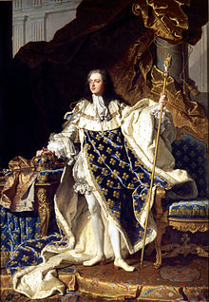
LOUIS XV
Yes, the next king after Louis XIV was the logical Louis XV. Tough to remember, I know. This was the grandson of Louis XIV, as mentioned earlier.
Where Louis XIV was a grand success, Louis XV is remembered as something of a failure. In fact, by the end of his reign, many of the successes achieved by Louis XIV had been lost – France had lost its colonies in North America to Britain, the treasury was near dry, the monarchy was discredited and the people were sufficiently destitute and dissatisfied to be ready for an uprising. Like the Louis before him, it would be his grandson that would take over as the next king.

Slide 7
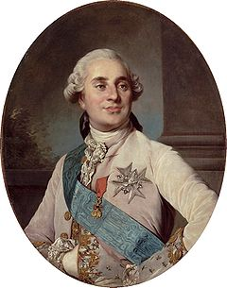
LOUIS XVI
France just can’t get enough Louis. This Louis would inherit a country in deep economic crisis and weakened from the empire at its height under Louis XIV. It was kind of like getting handed the controls of a plane as it’s flying into a mountain…
However, it’s important to remember what he did, or didn’t do to help things along. He wasn’t exactly responsive to the needs of the people. Like Louis XV, he was liked at first, but then his conservatism would anger many in France and he simply became a symbol of a system of government that was corrupt and inept. He didn’t last as long as his forbears…

Slide 8
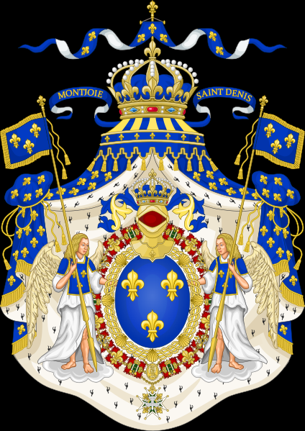
THE “ANCIEN” REGIME
The monarchy, of course, was not the sole reason for France’s revolution. The entire system was broken.
The existing system of taxation, as well as being unfair to the third estate, was very complex, and full of loopholes that allowed the nobility to escape taxation (the clergy didn’t need loopholes – they were exempt!)
There were also chronic problems created through irregularities, as legal and administrative divisions overlapped, creating confusion over who was responsible for what.

Slide 9
French Society
French society was divided into 3 classes called “Estates”:
First Estate
Catholic church officials &Clergy
1st
2nd Estate
Nobility & aristocracy
3rd Estate
Bourgeoisie – educated city lawyers, doctors, businessmen
Peasants & farmers
2nd
3rd

Slide 10
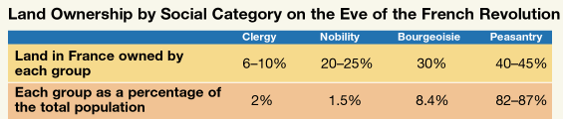
THE “ANCIEN” REGIME CONT’D
The land ownership system in France was also extremely good at promoting and maintaining the old order, as the clergy and nobility owned WAY more land than they should have, considering the small percentage of society they represented. This created a huge wealth gap.

Slide 11
The 1st Estate
Only 2% of population
Own 10% of land
Pay NO taxes

Slide 12
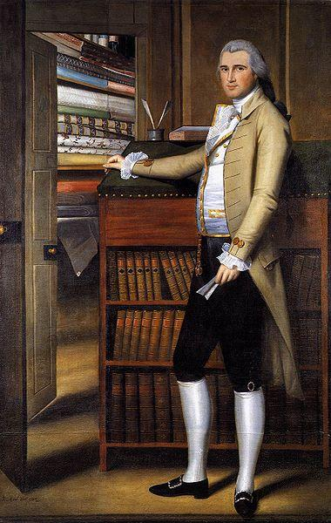
The 2nd Estate
1.5- 3% of population
Own 20-25% of the land
Pay NO TAXES
Control government & live off collected tax money

Slide 13
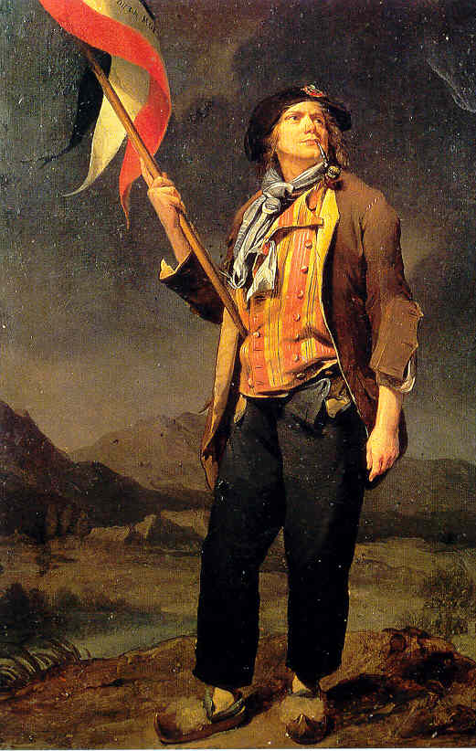
The 3rd Estate
95% of population
Almost no say in government
Pay all the taxes
Pay tithes to Church

Slide 14
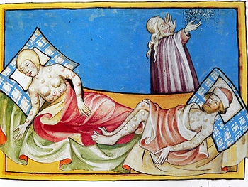
THE BLACK DEATH
Whoa – wait a second! The Black Death? How can that be a cause of the Revolution? That was way back in 1348! That’s nowhere near the time of the French Revolution.
True, but it can be argued that there’s a connection.
Here’s how…

Slide 15
THE BLACK DEATH CONT’D
The Black Death was the first “global” pandemic. It struck Europe in the mid 14th century, and boy, was it good at one thing – KILLING PEOPLE.
It spread due to bacteria found in rats and their fleas that infect the human lymphatic system and cause “buboes” (swellings) – hence the “bubonic plague” (or as many called it, the plain old “plague”).
It was thought that the bacteria was brought back to Europe when trade along the Silk Road (between China) opened up around that time.

Slide 16
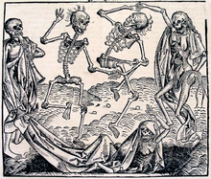
THE BLACK DEATH, CONT’D
The plague killed millions, reducing the world’s population from an estimated 450 million at the time to 375 million, and Europe, which was hardest hit, lost 40-60% of all its people.
It was biblical in proportion, and indeed, many people thought it was the end of the world.

Slide 17
THE BLACK DEATH CONT’D
However, the Black Death had some far-reaching consequences, not all of them bad.
The population that was left after the Black Death was over was very young, and the young brought a lot of fresh, new ideas about how things should be done with them.
The aftermath left people to rebuild society, and a lot of people thought about how society could be built back better than it was before.

Slide 18
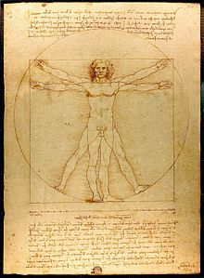
THE RENAISSANCE
“Renaissance” actually means, “rebirth” and many historians believe the Renaissance was only possible after a catastrophe as great as the Black Death.
The Renaissance was a far-reaching cultural movement that spread across Europe from the 14th to the 17th century, in which people took a great interest in “humanist” pursuits.

Slide 19
THE RENAISSANCE, CONT’D
Scholars and others in this period were re-discovering old texts from the Greek and Roman periods, and were also re-thinking their approach to religion.
People didn’t abandon religion – quite the opposite – but they did start spending a lot more time thinking about life on Earth and less about the afterlife.
This inspired generations of Europeans, and many famous thinkers, scientists and artists are associated with this time period, including Martin Luther, Michelangelo, Leonardo Da Vinci, Rene DesCartes, Copernicus, Isaac Newton and William Shakespeare.

Slide 20
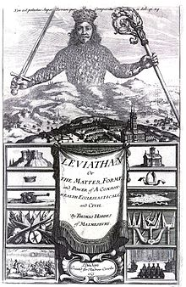
THE ENLIGHTENMENT
The Renaissance paved the way for the Enlightenment, which was a sort of “revolution” in the 18th century in which people began to believe that reason was the primary source of legitimacy and authority.
Enlightenment thinkers such as Thomas Hobbes, Voltaire, Montesquieu and John Locke, advocated rights for individuals and representation of the people.

Slide 21
THE ENLIGHTENMENT, CONT’D
While not all Enlightenment thinkers were against the monarchy, many of them were, and as a powerful educated merchant class developed in Europe that was apart from the nobility, many of them felt that the system of government as it was didn’t really represent them and wasn’t very reasonable.
This was particularly true for many British colonists living abroad, as many of them felt that they should have more of a say as to how they were governed. For 13 colonies in North America, the perceived injustices against them would lead them to a revolution of their own…

Slide 22
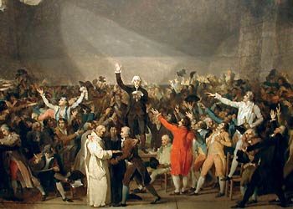
Age of Enlightenment
Appealed to bourgeoisie grievances
Challenged the absolute right to rule
Liberal society

Slide 23
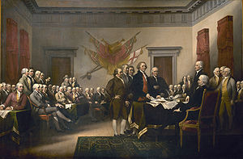
THE AMERICAN REVOLUTION
In 1776, colonies in what was then British North America joined together and declared themselves to be a separate country – the United States of America.
Led by such Enlightenment thinkers as Thomas Jefferson, the colonists would shake off control by Britain and establish a new country with a system of government that has been the basis for other democracies around the world.

Slide 24
THE AMERICAN REV., CONT’D
It was a really big deal. No country had been established this way before, and people took notice.
In fact, the Americans were helped every step of the way in their fight against Britain by its enemy, France (the French just loved the fact that Britain was now going to lose a big chunk of its overseas empire, and wanted to do everything they could to help the process).
The French actually committed substantial resources to help the colonists in their revolution – this actually hurt France as it drained its already low treasury.
However, this help had another unexpected consequence – the Americans’ ideas kind of rubbed off on the French. Many of them got caught up in the Americans’ passionate fight against a tyrannical monarchy and thought, “Well, hey, if they can do it…”

Slide 25
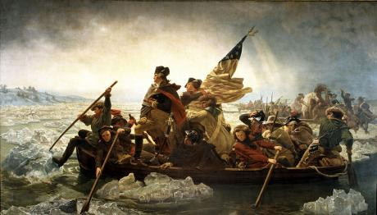
Sent Aid and Supplies to American Revolution
France is introduced to revolutionary ideas
A republic is superior to a monarchy
Take up arms against tyranny
Liberal freedoms for all men
No taxation without representation

Slide 26
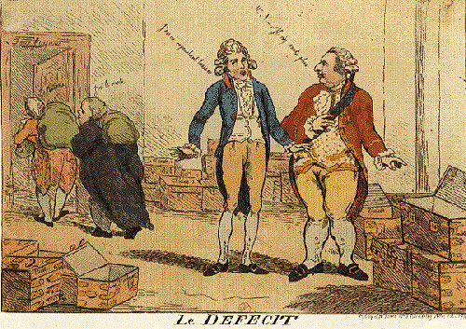
IMMEDIATE CAUSES
OK, so we’ve seen a lot of the “big issue” stuff, but there were also a number of little things that set the wheels of the revolution in motion.
The first was certainly an economic crisis in the late 18th century – France had a huge deficit and prices were going up as a result, making the difficulties experienced by many of the poor even worse.
A cartoon in late 18th century France which asks: “Where is the tax money?”

Slide 27
ECONOMIC WOES
The economic crisis was a matter of income vs. expenditure: France was spending more money than it was bringing in.
While it might be easy to dismiss this as a problem of the monarchy and nobility only, as they were the ones that depended on the income of taxes, consider what the crisis did to the price of bread, and how that would have affected the peasants of the 3rd estate.
Look at the table here to get an idea.

Slide 28
POPULATION CRUNCH
Added to France’s economic problems was the fact that it had a substantially large population to worry about – it had 20 million people living within its borders on the eve of the revolution. This was roughly 1/5 of all of non-Russian Europe. That’s a lot of people for one place.
This created problems of over-crowding and poor conditions in the country’s cities, as well as employment difficulties in the countryside, as peasants looked desperately for work so that they could afford to feed their families.
To make matters worse, France was experiencing droughts in the 1780s, which put even more of a squeeze on its already low food supply to feed its vast population.
While the population crunch developed as a long term problem, it had an immediate effect on problems like food shortages.

Slide 29
THE NECKLACE SCANDAL
We’ll learn more about Louis XVI’s wife Marie Antoinette later, but for now it’s worth mentioning the scandal her jewelry touched off.
Louis XV had commissioned an insanely expensive necklace to be made for a woman he was infatuated with. However, the necklace wasn’t completed until after his death, so the jewelers who were instructed to make it thought they could sell it to the new king, Louis XVI, to give to his lovely bride, Marie Antoinette.
The necklace was worth about 2 000 000 livres, or over $100 000 000 of our money.

Slide 30
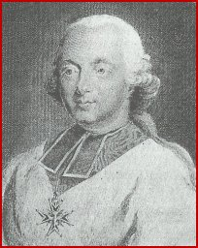
NECKLACE SCANDAL CONT’D
The only problem was, the Queen refused to take it. Lots of speculation about why, from she didn’t want to wear something made for another woman, to saner ideas, like the money would be better spent on other things.
That might not seem like a big deal, but the story doesn’t end there. A lustful Cardinal who wanted to be closer to the Queen was tricked by a female con artist, Jeanne de Saint-Remy de Valois, into arranging to have the necklace delivered to the Queen, as a gift for her.
When a bill for the necklace showed up on the Queen’s doorstep, all hell broke loose.

Slide 31
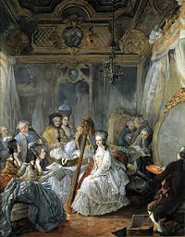
NECKLACE SCANDAL CONT’D
The con artist was put on trial, and the Cardinal made bad comments about the Queen’s “moral character” - a black stain was put on Antoinette.
To make matters worse, the French public were convinced that Jeanne de Saint-Remy de Valois’ memoirs, which were published shortly before the outbreak of the Revolution (and painted the whole thing as the Queen’s fault) were the true account of the affair.
Of course, none of it was true (she was a really good con artist), but all this made the French public hate the Queen, and believe the royal family were a bunch of extravagant, spoiled idiots that did nothing but have affairs and spend money.

Slide 32
ESTATES GENERAL
In May of 1789, the king called a meeting of the “Estates-General,” or an assembly of delegates representing each estate (1st - the clergy, 2nd - the nobility, and 3rd - everyone else) to address all the problems that France was experiencing.
It was the first time the estates had met in this way since 1614.
There was a big turnout – 1201 delegates, which included 291 nobles, 300 members of the clergy, and 610 members of the third estate (merchants and peasantry).

Slide 33
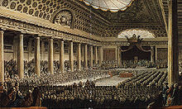
ESTATES GENERAL, CONT’D
The process seemed doomed from the start. A book of “grievances” was given to delegates, outlining the problems currently faced by France and possible solutions for them, but no one was proposing any radical changes to the system.
As well, the rules of the 1614 estates-general were invoked, in which each estate had one vote, and any two estates could override the third.
Needless to say, the third estate didn’t like any of this, and decided to have a meeting of its own.

Slide 34
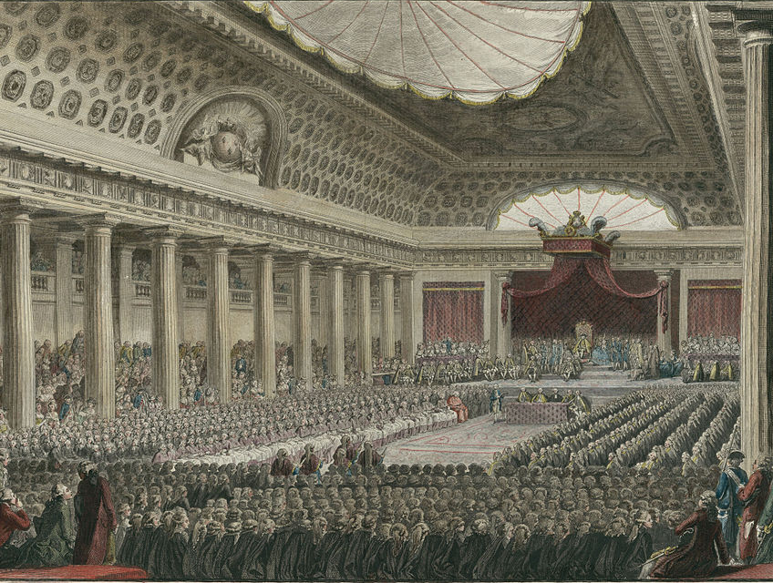
The Estates General
Type of representation
Rarely meet
1 vote per Estate
3rd Estate ALWAYS outvoted

Slide 35
THE NATIONAL ASSEMBLY
Members of the third estate called their own meeting, in which they were to proceed with “verification” of their own powers. The other estates were invited to join, but the third estate vowed not to wait for them.
In June of 1789, the members voted to declare themselves the “National Assembly,” effectively challenging the king’s authority.
Again, they invited members of the other estates to join them, but made it clear they would begin making decisions about the country’s affairs with or without them.

Slide 36
THE TENNIS COURT OATH
When Louis XVI heard about this, he was royally ticked off (excuse the pun). He ordered the Salle des Etats, where the Assembly was meeting, to be closed. The National Assembly thus moved their meetings to a nearby indoor tennis court.
There they swore an oath not to separate until they had given France a constitution. A majority of the representatives of the clergy soon joined them, as did 47 members of the nobility.
Messages of support for the Assembly poured in from Paris and other French cities, and the Revolution was underway.

Slide 37
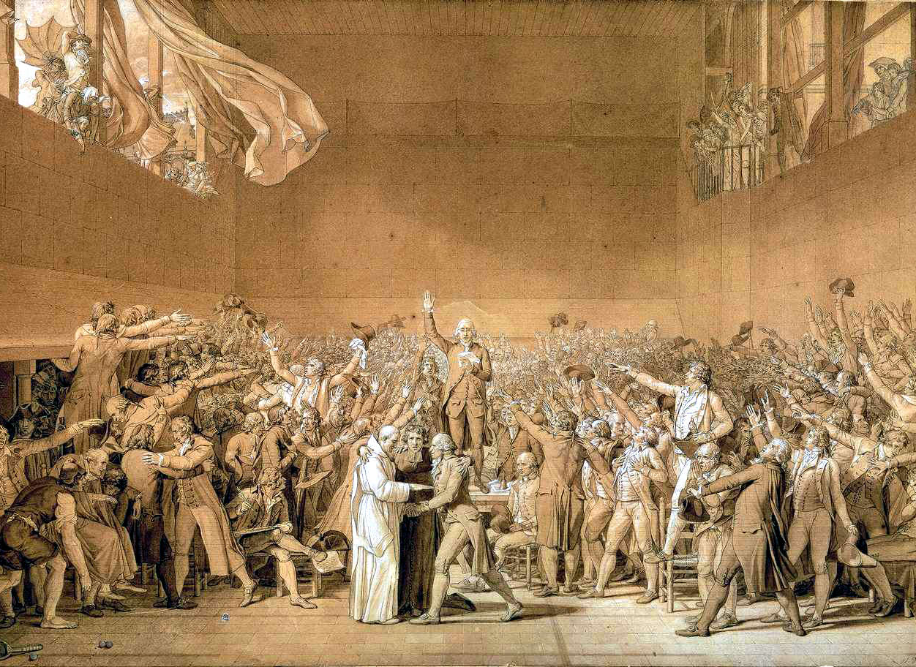
The National Assembly
Locked out of the Estates General, 3rd Estate signs the Tennis Court Oath
Creates a National Assembly
Issue the Declaration of the Rights of Man and of the Citizen

Slide 38
THE END OF THE BEGINNING
Things from here would get more interesting, and a little messy.
There was debate, protest, and violence, and in the years that followed, France was plunged into a long period of upheaval.
However, these events would forever transform the country, and the world. France’s example proved that democracy was not just a colonial idea – it was going to spread like wildfire across Europe.
Sure, lots of countries resisted it, and the move to democracy was slower in some places, but it still proved the power that the people had to take control of their country, and their destiny.
Above all, it cemented a belief in French society in three ideals of the revolution – Liberty, equality and fraternity. These were part of a larger central belief that the people of France, not its rulers, were deserving of freedom and a better life.

